Slide 1
A comprehensive professional development model
Kim Kirby
Instructor/Carl Perkins Grant Coordinator

Slide 2
Convergence of Initiatives
Carl Perkins
Focus especially on special pops group: economically disadvantaged
Arkansas Career Pathways Initiative
project designed to improve the earnings and postsecondary education attainment of Arkansas’s low –income Temporary Assistance for Needy Families (TANF)-eligible adults
Achieving the Dream
National community college initiative concerned about student groups that traditionally have faced significant barriers to success

Slide 3
YEAR 1: 2007-2008
BRIDGES OUT OF POVERTY
Strategies for Professionals and Communities
By Ruby K. Payne, Ph.D., Philip E. DeVol, Terie Dreussi Smith

Slide 4
FORMAT: BOOK CLUB
Development
Developed by CAO & Perkins Coordinator
Schedule created during summer 2007
Goals
Develop schedule for entire year
Involve as many people as possible
Encourage participant interaction
Make information accessible
Administrative Support

Slide 5
KICK OFF - AUGUST
Perkins purchased a book for faculty, adjunct faculty and professional staff
PCCUA purchased a book for all other employees and board members
Books given out at opening breakfast in-service & adjunct orientation and schedule announced

Slide 6
SEPTEMBER
Breakfast discussion 7:30-8:30 AM
Small group discussions held on each campus
Breakfast provided by administrator on each campus
Discussion questions (chapters 1-4) given to moderators and emailed to all faculty/staff
Notes taken at each discussion and posted online (important for those unable to attend)

Slide 7
OCTOBER
All campus in-service
Watched PBS special: Discounted Dreams
Large group discussion
Broke into small groups (approximately 20 people) with a mix of faculty, administrators, classified and non-classified staff
Discussions led by faculty and professional staff
Notes from each small group posted online

Slide 9
NOVEMBER
Brown Bag Lunch Discussion
Small group discussions held on each campus
BYOL: Bring Your Own Lunch
Discussion questions (chapters 6-8) given to moderators and emailed to all faculty/staff
Notes taken at each discussion and posted online

Slide 10
NOVEMBER
Workshop
Perkins advisory team attend a Ruby Payne workshop: A Framework for Understanding Poverty
6 funded through Perkins: Perkins Coordinator, CAO, Dean of Arts & Sciences, Dean of Developmental Education, Student Success Coordinator, Career Pathways Director
2 funded through Title III: Title III Director, Student Success Coordinator

Slide 11
DECEMBER/JANUARY
Final Exams/New Semester
No group activities planned during December and January
Email reminder of website
Avoid burnout

Slide 12
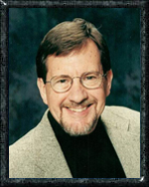
FEBRUARY
Phil DeVol
Co-author of Bridges Out of Poverty: Strategies for Professionals and Communities & author of Getting Ahead in a Just-Gettin’-By World: Building Your Resources for a Better Life
Full-day in-service for all faculty and staff
Perkins purchased workbooks for faculty and staff, PCCUA purchased workbooks for all other employees

Slide 13
MARCH
Brown Bag Lunch Discussion
Small group discussions held on each campus
BYOL: Bring Your Own Lunch
Discussion questions (chapters 9-12) given to moderators and emailed to all faculty/staff
Notes taken at each discussion and posted online

Slide 14
APRIL
Breakfast Discussion
Same format as September
7:30-8:30 AM
Breakfast provided by campus administrators/potluck
Discussion questions (chapters 13-16) provided to moderators and faculty/staff
Notes taken at each discussion and posted online

Slide 15
MAY
Email survey
Survey of satisfaction with professional development activity
Suggestions for incorporating Bridges into college culture
Suggestions for future professional development activities

Slide 16
WEBSITE

Slide 17
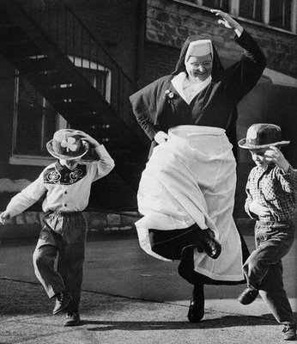
RESULTS
Positive Feedback
Book choice
Book club format (small group discussions)
Discussion note postings on website
Still talking about it!

Slide 18
YEAR 2: 2008-2009
THEM
By Nathan McCall
Fiction book
Recommended by Title III Director, Student Success Coordinator/faculty

Slide 19
THEM

Slide 20
KICK OFF: AUGUST
Presented schedule at opening breakfast in-service
Books delivery delayed
Perkins purchased books for faculty, adjunct faculty, and professional staff
PCCUA purchased books for all other employees
Students Services purchased books for several classes (Psychology, Sociology)

Slide 21
OCTOBER
Breakfast discussion 7:30-8:30 AM
Small group discussions held on each campus
Breakfast provided by administrator on each campus
Discussion questions (chapters 1-8) given to moderators and emailed to all faculty/staff
Notes taken at each discussion and posted online (important for those unable to attend)

Slide 22
NOVEMBER
Brown Bag Lunch Discussion
Small group discussions held on each campus
BYOL: Bring Your Own Lunch
Discussion questions (chapters 9-26) given to moderators and emailed to all faculty/staff
Notes taken at each discussion and posted online

Slide 23
DECEMBER/JANUARY
Final Exams/New Semester
No group activities planned during December and January
Email reminder of website
Avoid burnout

Slide 24
FEBRUARY (early)
Breakfast discussion 7:30-8:30 AM
Small group discussions held on each campus
Breakfast provided by administrator on each campus
Discussion on entire book
Notes taken at each discussion and posted online

Slide 25
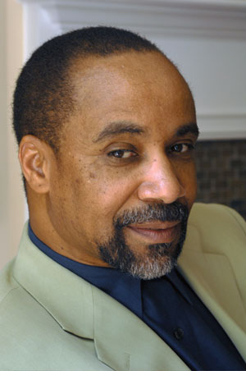
FEBRUARY (late)
Faculty-Staff In-service (1/2 day)
Discussion led by author, Nathan McCall
Q&A with author
Helena-West Helena campus book club students also read book and attended

Slide 26
APRIL
Follow up discussions on each campus
Wanted to “reach” those who may not have read the book until after the author visited.

Slide 27
SPRING
Evaluation of February in-service
online
Both positive and negative feedback
Negative comments were from classified staff, not faculty/professional staff
Topic of race relations made some people uncomfortable

Slide 28
Website

Slide 29
WHAT WORKED?
Sustained activities covering full academic year
Schedule presented at beginning of year
Flexible scheduling
Small groups with informal discussion
Posting notes online / sharing
Administrative support
Topics current with other initiatives

Slide 30
QUESTIONS?

Slide 31
CONTACT INFO
Kim Kirby
Phillips Community College of the University of Arkansas (PCCUA)
kkirby@pccua.edu

